Slide 1
DIY FINAL PROJECT IMPLEMENTATION OF GESTURE BASED CONTROLS USING ARDUINO
YASH RANA
20PH20045
DEEPA RAJ
20IM10006
TEAM -7
SNEHA KUMARI
20IM30020
G CHETAN
20ME30021

Slide 2
WEEK-WISE DISTRIBUTION OF THE PROJECT
WEEK-1
Discussion on the DIY Project and ordering of the hardwares required
Preparation of the presentation file describing the Project
WEEK-2
Working on the circuit (Using Tinkercad)
Working on the logic(Algorithm) using python
WEEK3
Completing the code and the model
Making of the Video explaining our DIY Project
Making of the Prototype Model
Test Run

Slide 3
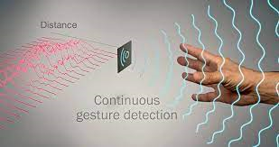
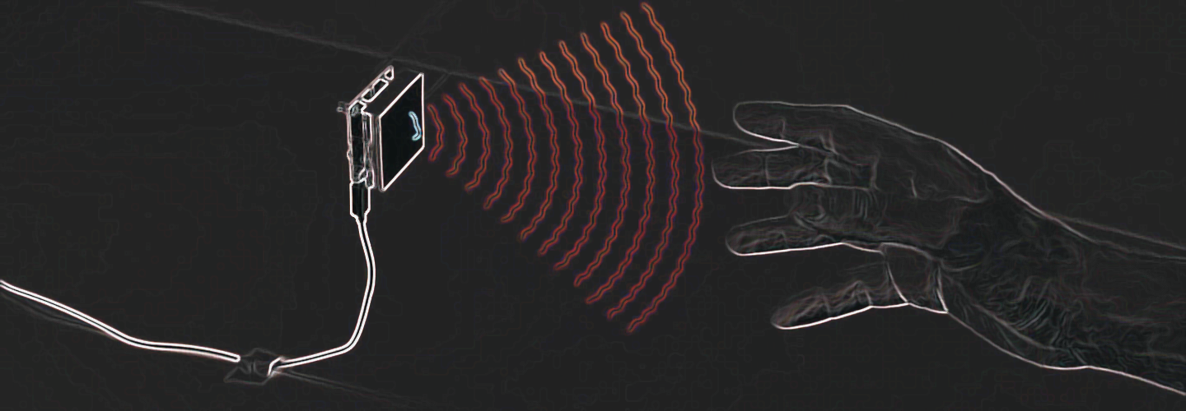
INTRODUCTION
Recently Gesture controlled Laptops or computers are getting very famous. This technique is called Leap motion which enables us to control certain functions on our computer/Laptop by simply waving our hand in front of it. It is very cool and fun to do it, but these laptops are really priced very high. So in this project let us try building our own Gesture control Laptop/Computer by combining the Power of Arduino and Python. We will use two Ultrasonic sensors to determine the position of our hand and control a media player (VLC) based on the position. I have used this for demonstration, but once you have understood the project, you can do anything by just changing few lines of code and control your favorite application in your favorite way.
The concept behind the project is very simple. We will place two Ultrasonic (US) sensors on top of our monitor and will read the distance between the monitor and our hand using Arduino, based on this value of distance we will perform certain actions. To perform actions on our computer we use Python pyautogui library. The commands from Arduino are sent to the computer through serial port (USB). This data will be then read by python which is running on the computer and based on the read data an action will be performed.

Slide 4
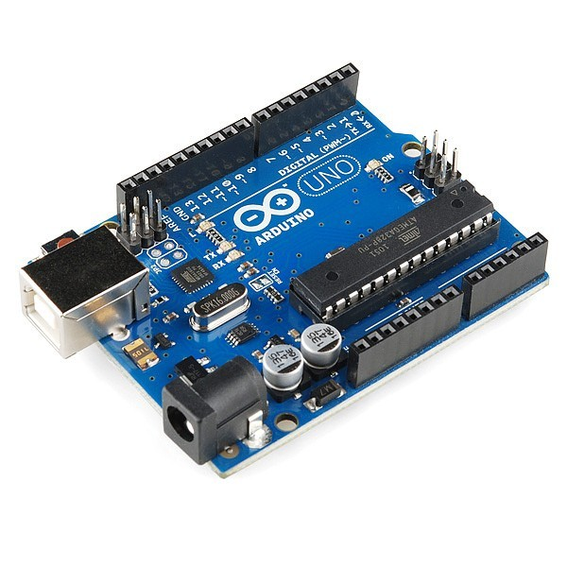
COMPONENTS REQUIRED:
ARDUINO UNO R3
IT is a microcontroller board based on the ATmega328P
The distance between our hands and the two US sensors is read using Arduino!
The commands from Arduino are sent to the computer through serial port (USB)

Slide 5
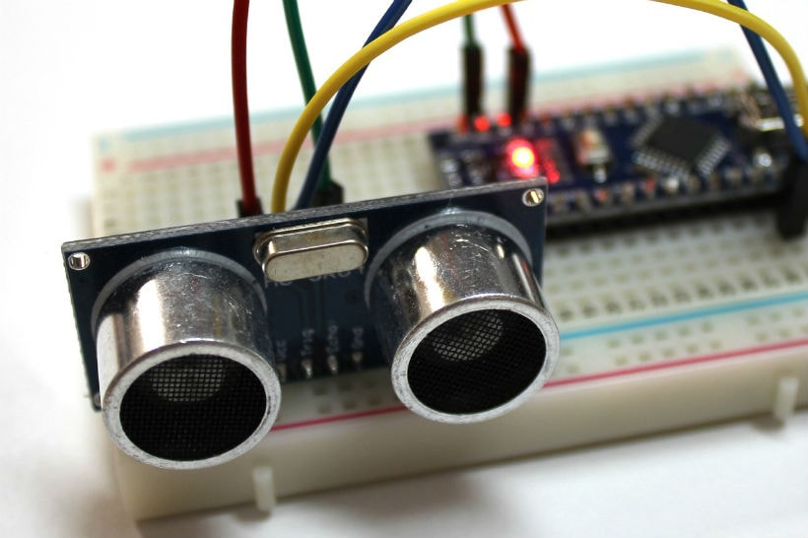
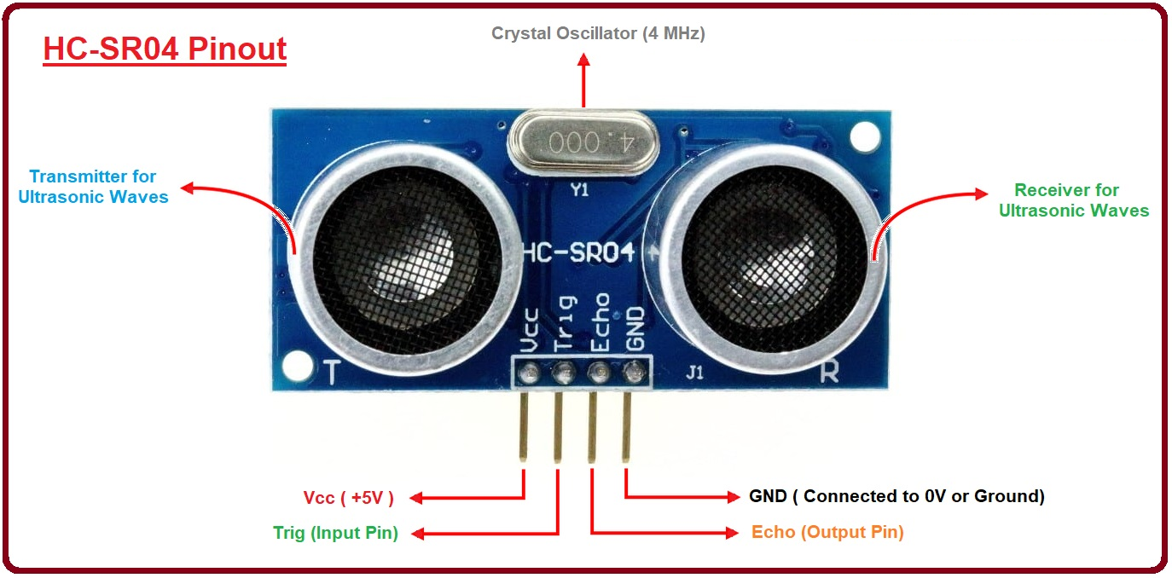
2)TWO ULTRASONIC(US) SENSORS
It measures the distance to an object using ultrasonic sound waves.
It uses a transducer to send and receive ultrasonic pulses that relay back information about an object’s proximity.
High-frequency sound waves reflect from boundaries to produce distinct echo patterns.
The sensor determines the distance to a target by measuring time lapses between the sending and receiving of the ultrasonic pulse.

Slide 6
By calculating the travel time and the speed of sound, the distance can be calculated.

Slide 7
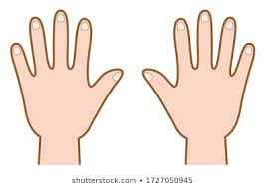
WORKING OF OUR MODEL
To control the PC with Hand Gestures, just connect the two Ultrasonic sensors with Arduino. We know US sensor work with 5V and hence they are powered by the on board Voltage regulator of Arduino. The Arduino can be connected to the PC/Laptop for powering the module and also for Serial communication.
Here are the explaination and depiction of 5 movements that we will use in our model as follows…..
Action 1: When both the hands are placed up before the sensor at a particular far distance then the video in VLC player should Play/Pause.
Play/Pause

Slide 8
Action 2: When right hand is placed up before the sensor at a particular far distance then the video should Fast Forward one step.
Fast forward
one time
Action 3: When left hand is placed up before the sensor at a particular far distance then the video should Rewind one step.
Rewind one step
Action 4: When right hand is placed up before the sensor at a particular near distance and then if moved towards the sensor the video should fast forward and if moved away the video should Rewind.
Fast forward
rewind
Action 5: When left hand is placed up before the sensor at a particular near distance and then if moved towards the sensor the volume of video should increase and if moved away the volume should Decrease.
Volume increase
Volume decrease

Slide 9
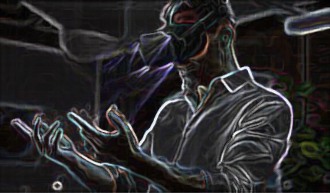
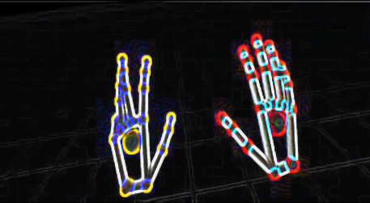
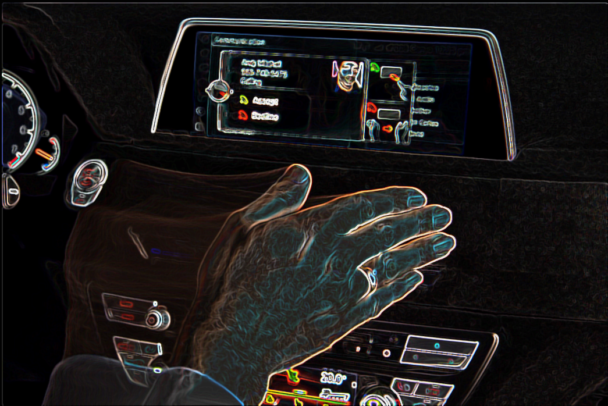
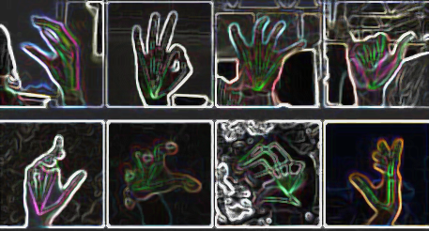
REAL LIFE APPLICATIONS:
Gesture recognition can be seen as a way for computers to begin to
understand human body language.Hand gesture detection is being
widely used in many applications such as Virtual reality gaming ,
physical rehabilitation , communication , and inclusion.Even modern
cars these days use hand gesture recognition for various functions.

Slide 10
THANK YOU

